Slide 1

LIVER DISEASE ANALYSIS

Slide 2
Project Phase II
Submitted by:
Md Irfan Khan : 3GN17CS400
Pooja Tandle : 3GN16CS056
Pawar Arathi : 3GN16CS055
Under the Guidance of:
Prof: RAGEENA M

Slide 3
Introduction
The model is derived based on the analysis of a set of training liver data i.e, data objects for which the class labels are known.
The model is used to predict the class label of objects for which the class label is having the liver disease or not having a liver disease that is unknown.
Machine learning investigates how computers can learn (or improve their performance) based on liver data.
The main research area is for computer programs to automatically learn to recognize complex patterns and make intelligent decisions based on liver data.

Slide 4


PYTHON LANGUAGE
AI Machine learning is the scientific study of algorithms and
Statistical models that computer systems use in order to perform a specific task effectively without using explicit instructions, relying on patterns and inference instead. It is seen as a subset of artificial intelligence
Python is a very powerful programming language used for many different applications. Over time, the huge community around this open source language has created quite a few tools to efficiently work with Python.
PYTHON
AI MACHINE LANGUAGE

Slide 5
What are Liver Function
What are Common Liver Diseases
The liver has a multitude of important and complex functions. Some of these functions are to:
Manufacture (synthesize) proteins, including albumin (to help maintain the volume of blood) and blood clotting factors
Synthesize, store, and process (metabolize) fats, including fatty acids(used for energy) and cholesterol
Metabolize and store carbohydrates, which are used as the source for the sugar (glucose) in blood that red blood cells and the brain use
The most common liver diseases are various types of:
Acute (sudden) hepatitis (inflammation),
Chronic (long duration) hepatitis,
Fatty liver disease,
Cirrhosis (scarring), and
Cancer

Slide 6
Analysis
The proposed system is built expert system which employs for the diagnosis of LDs is developed in an environment Neuroph and Crystal's reports were used for analysis.
Approach for analyzing clusters to identify a meaningful pattern for determining whether a patient suffers from LD or not is presented.
The system provides a guide for the diagnosis of LDs within the decision-making framework.
The process for the medical diagnosis of LD starts when an individual consults a physician (doctor) and presents a set of complaints (symptoms).
The physician then requests further information that will further aid in the proper diagnosis of the disease.

Slide 7
DESIGN MODEL
Random Forest
Model
Gaussian Naive
Bayes
Logistic Regression
Decision Tree Classifier

Slide 8
Random Forest Regression
A Random Forest is an ensemble technique capable of performing both regression and classification tasks with the use of multiple decision trees and a technique called Bootstrap Aggregation, commonly known as bagging.
Accuracy scored:0.68
Gaussian Naive Bayes Classifier
Naive Bayes is a classification algorithm for binary (two-class) and multi-class classification problems. The technique is easiest to understand when described using binary or categorical input values. The representation for naive Bayes is probabilities.
Accuracy scored:0.5613
Logistic Regression
Since the outcome is binary and we have a reasonable number of examples at our disposal compared to number of features, this approach seems suitable. At the core of this method is a logistic or sigmoid function that quantifies the difference between each prediction and its corresponding true value.
Accuracy scored:0.7143
Decision Trees
Decision Trees are a non-parametric supervised learning method used for both classification and regression tasks. The goal is to create a model that predicts the value of a target variable by learning simple decision rules inferred from the data features.

Slide 9
Logistic Regression:
Since the outcome is binary and we have a reasonable number of examples at our disposal compared to number of features, this approach seems suitable.
At the core of this method is a logistic or sigmoid function that quantifies the difference between each prediction and its corresponding true value.
When presented with a number of inputs , it assigns different weights to features(based on their relative importance).
Since for this data it already knows the output beforehand, it continuously adjusts the weights such that when these weights summed up with their features are introduced in the logistic function, the results are as near as possible to the actual ones.
Once presented with a test value, it again inserts the value into our logistic function and returns the output as a number between 0 and 1, which represents the probability of that test value being in a particular class.
Accuracy scored:0.7143

Slide 10
Existing System
Even though different solutions have been successfully applied and implemented, they implement fewer models or algorithms on the different t datasets but the existing methods require a high computational cost.

Slide 11
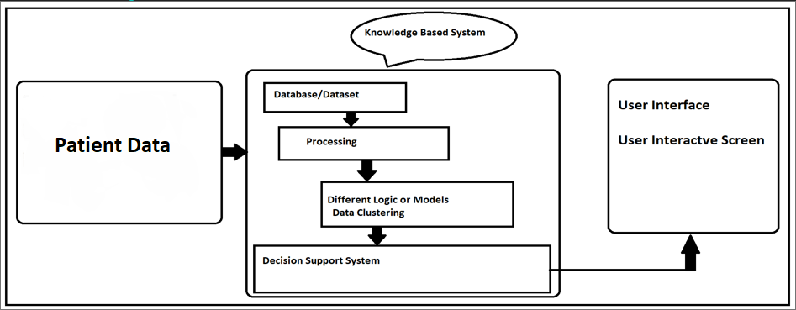
System Design

Slide 12
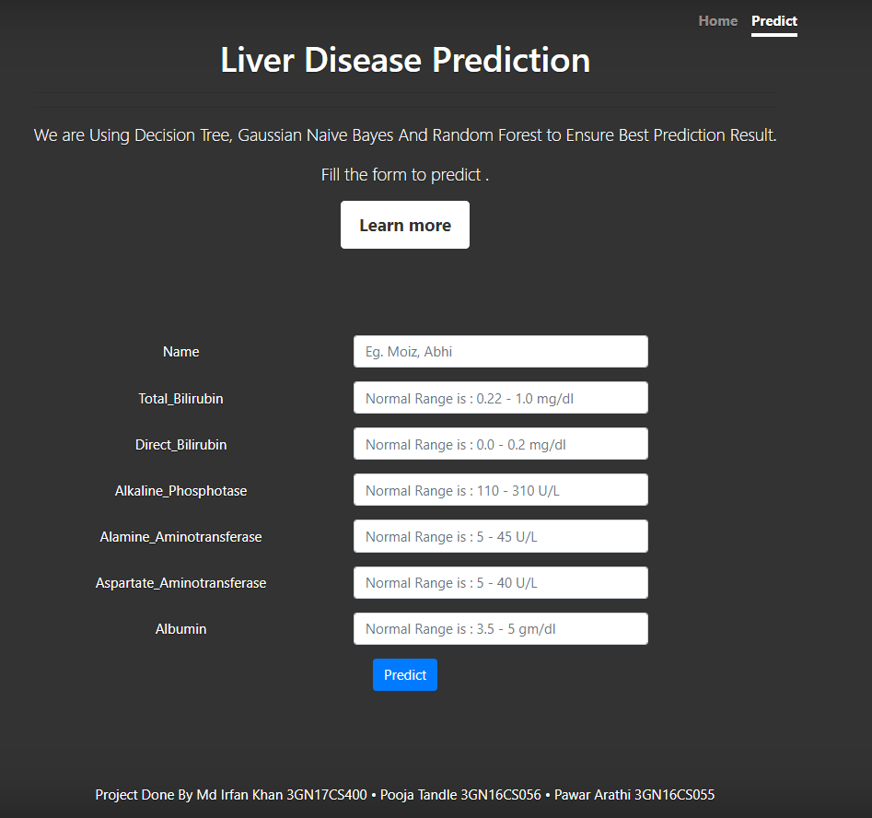
Design
FRONT-END DESIGN
we are creating form for accepting the values from the user, where we are using the HTML , CSS for creating the Front end of the project

Slide 13
Design
Back-End
With the help of Python packages and use of Spyder IDE we proceed with our design to implement the project:
1.Setting Spyder environment and importing packages Padas, Numpy & Webbrowser for running our code.
2. After the packages , we are collecting the data from the user
3. After inserting the values our model will predict the output.

Slide 14
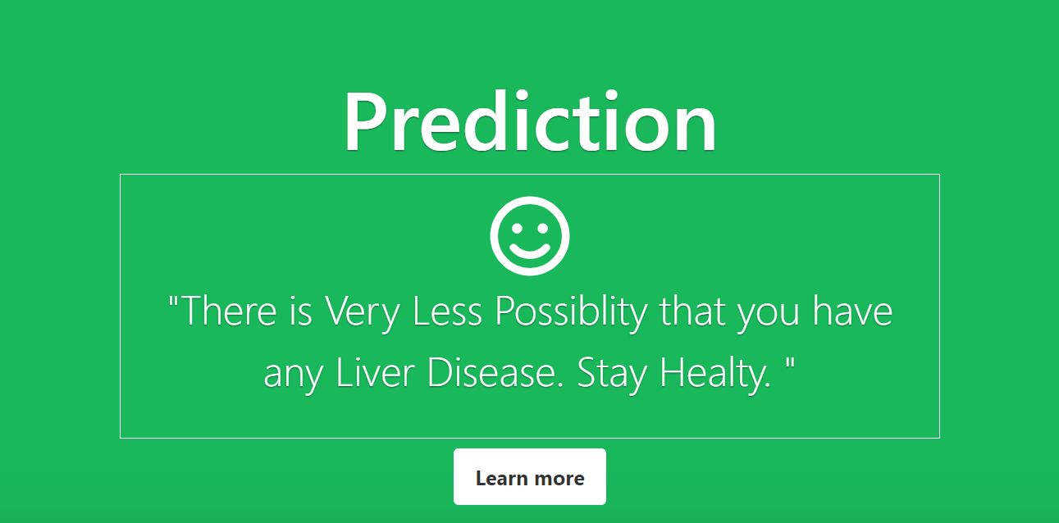
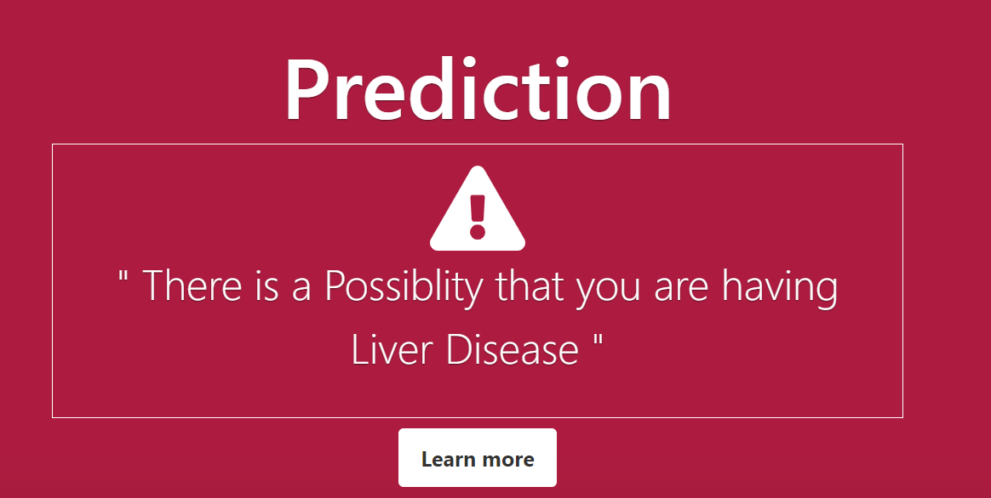
Output
Negative
Positive

Slide 15
System Requirements
HARDWARE REQUIREMENTS:
RAM : 4 GB
System Type : 64-bit OS
Processor : Intel® core i3-6000U CPU
Hard Disk : 125GB minimum

Slide 16
System requirements
Software Requirements:
OS : Windows XP – 10, Kali Linux
Software : Python (MatLab, Pandas,Numpy,Flask, Spyder (IDE)).
Languages : Python.
User Interface : HTML,CSS, JavaScript &Bootstrap.

Slide 17
Future Scope
This paper gives a thought of machine learning calculations accessible for discovery and determination of liver illness. From the examine it very well may be unmistakably seen that diverse managed learning calculations Support Vector Machine give improved exactness on discovery of liver maladies.

Slide 18
Conclusion
Firstly, a naive predictor and a benchmark model ('Logistic Regression') were run on the dataset to determine the benchmark value of accuracy. The greatest difficulty in the execution of this project was faced in two areas- determining the algorithms for training and choosing proper parameters for fine-tuning. Initially, I found it very vexing to decide upon 3 or 4 techniques out of the numerous options available in sklearn.

Slide 19
References
Nazmun Nahar and Ferdous Ara, "Liver disease prediction by using different decision tree techniques", International Journal of Data Mining & Knowledge Management Process (IJDKP),Vol.8, No.2, March 2018.
Divya, B, Kalaiselvi, R, Review on Confidentiality of the Outsourced Data, Research Journal of Science and Engineering Systems, vol.1, pp.1-7, 2017.
Hassoon, M, Kouhi, M S, Zomorodi-Moghadam, M, & Abdar, M, Rule optimization of boosted c5. 0 classification using genetic algorithm for liver diseaseprediction. In 2017 International Conference on Computer and Applications (ICCA), pp. 299-305, IEEE, 2017.

Slide 20
Thank You

